Slide 1
🦖 Dino Game -Console C++ Project

Slide 2
📋 Project Description
Dino Game is a console-based endless-runner game implemented in C++.
It is inspired by the popular offline dinosaur game in Google Chrome, where a dinosaur runs endlessly and the player jumps to avoid obstacles.
The game runs in the Windows console and uses Windows-specific libraries (conio.h, windows.h) to handle real-time keyboard input, sound effects, and screen control.
It also provides a score counter, jump mechanic, obstacles (cacti), and sound feedback.

Slide 3
🎮 Game Play
The dinosaur (D) runs on the ground automatically.
The player controls the dinosaur by pressing the SPACEBAR to jump.
Random cacti (|) appear and move from right to left.
The player must jump over the cacti to avoid collision.
The longer the player survives, the higher the score.
When the dinosaur collides with a cactus, the game ends with a Game Over sound and final score display.

Slide 4
🚀 Features
✅ Real-time keyboard input for jumping.
✅ Jump mechanic with smooth up & down motion.
✅ Moving obstacles (cacti) that spawn at random intervals.
✅ Increasing score over time.
✅ Sound effects (Beep) for:
Jump
Game Over
✅ Clean and modern console UI with borders and live score.
✅ Fully commented and beginner-friendly C++ code.

Slide 5
🔧 Technical Details
Language: C++
Platform: Windows Console
Libraries Used:
<iostream> — basic input/output.
<conio.h> — for _kbhit() & _getch() to detect key presses without waiting.
<windows.h> — for Sleep() (delay), Beep() (sound), and system("cls") (clear screen).
<ctime> — to seed the random number generator.
<vector> — to store and manage multiple obstacles.

Slide 6
📜 Controls
Key Action
🎮 SPACEBAR - Jump over obstacle
🎮 Any key - Start the game / Exit after Game Over

Slide 7
📝 How It Works
🦖 Dinosaur Position:
The dinosaur stays fixed horizontally but moves up and down when jumping.
🌵 Obstacle (Cactus):
Represented by |, spawned at the right edge, and moves left one step per frame.

Slide 8
🕹 Game Loop
Checks for user input to jump.
Updates dinosaur position if jumping.
Updates obstacle positions.
Checks for collision.
Updates and displays score.
Refreshes the console screen each frame.

Slide 9
🎵 Sound Effects
Jump: High-pitched beep (Beep(1000, 100)).
Game Over: Low-pitched beep (Beep(400, 300)).
Jump → short beep.
Game Over → lower beep.

Slide 10
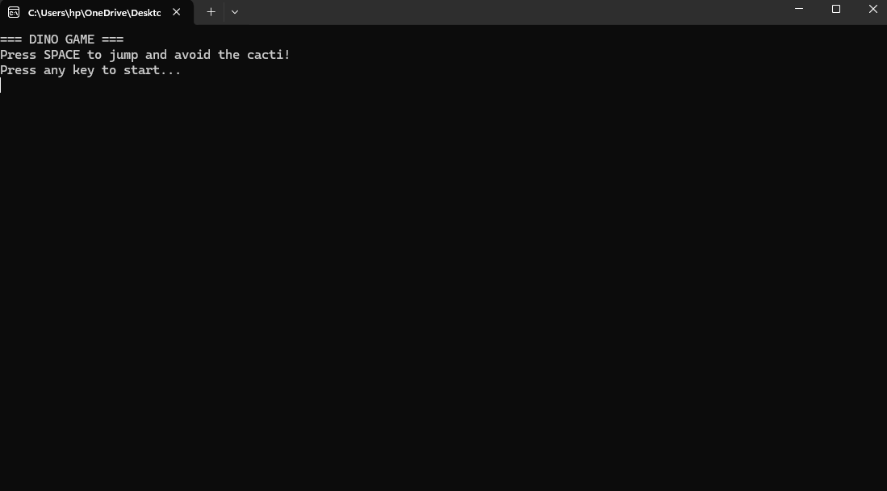
🧪 Sample Output & Gameplay Flow 1 Start screen → press any key to begin.

Slide 11
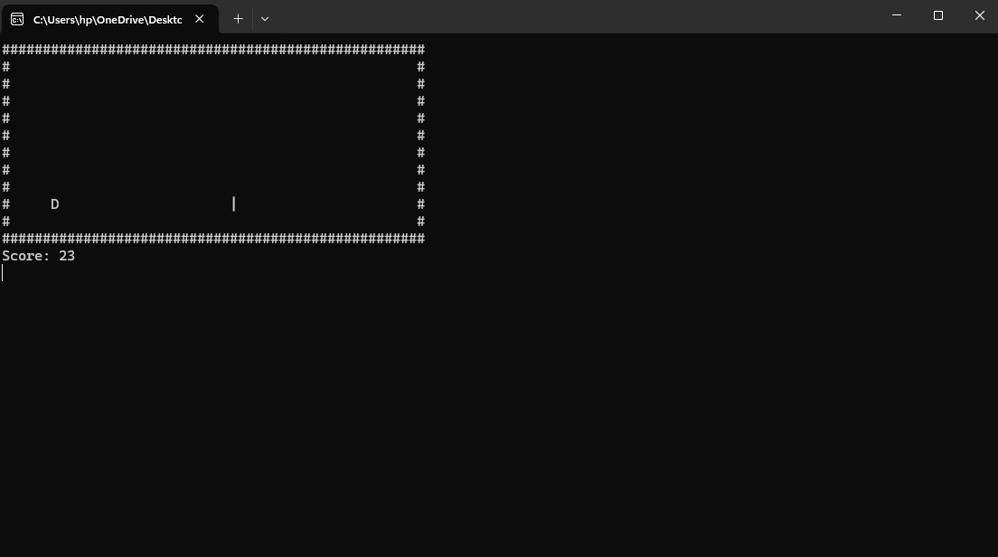
2 Game loop: Draw screen → check input → update jump → update obstacles → check collision → increment score → repeat.
(Dinosaur D jumps over moving cacti |)

Slide 12
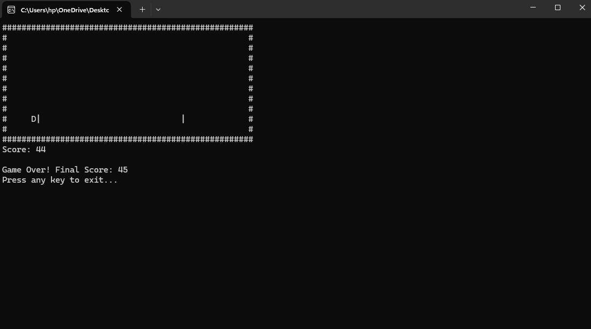
3 If collision → Game Over screen with final score. & Press any key to exit.

Slide 13
Thank you !

